Slide 1
Technight Hackathon
16-17 October 2024 IEEE PEC

Slide 2
AlphaByte CodeKraft
Anubhav Pathak (Leader)
Rishi Shekhar - Backend Developer
Chandranshu Jaimini – Frontend Developer
Bhavvesh Sharma – Backend Developer
Kartikeya Pandit – Frontend Developer

Slide 3
Our Hackathon journey
16 Oct
17 Oct
Visualizing the concepts and creating a roadmap.
Problem solving and debugging solutions.

Slide 4
Aim
01
conceptualizing solutions
02
Table of contents
Developing program
03
Concluding the Assembly
04

Slide 5

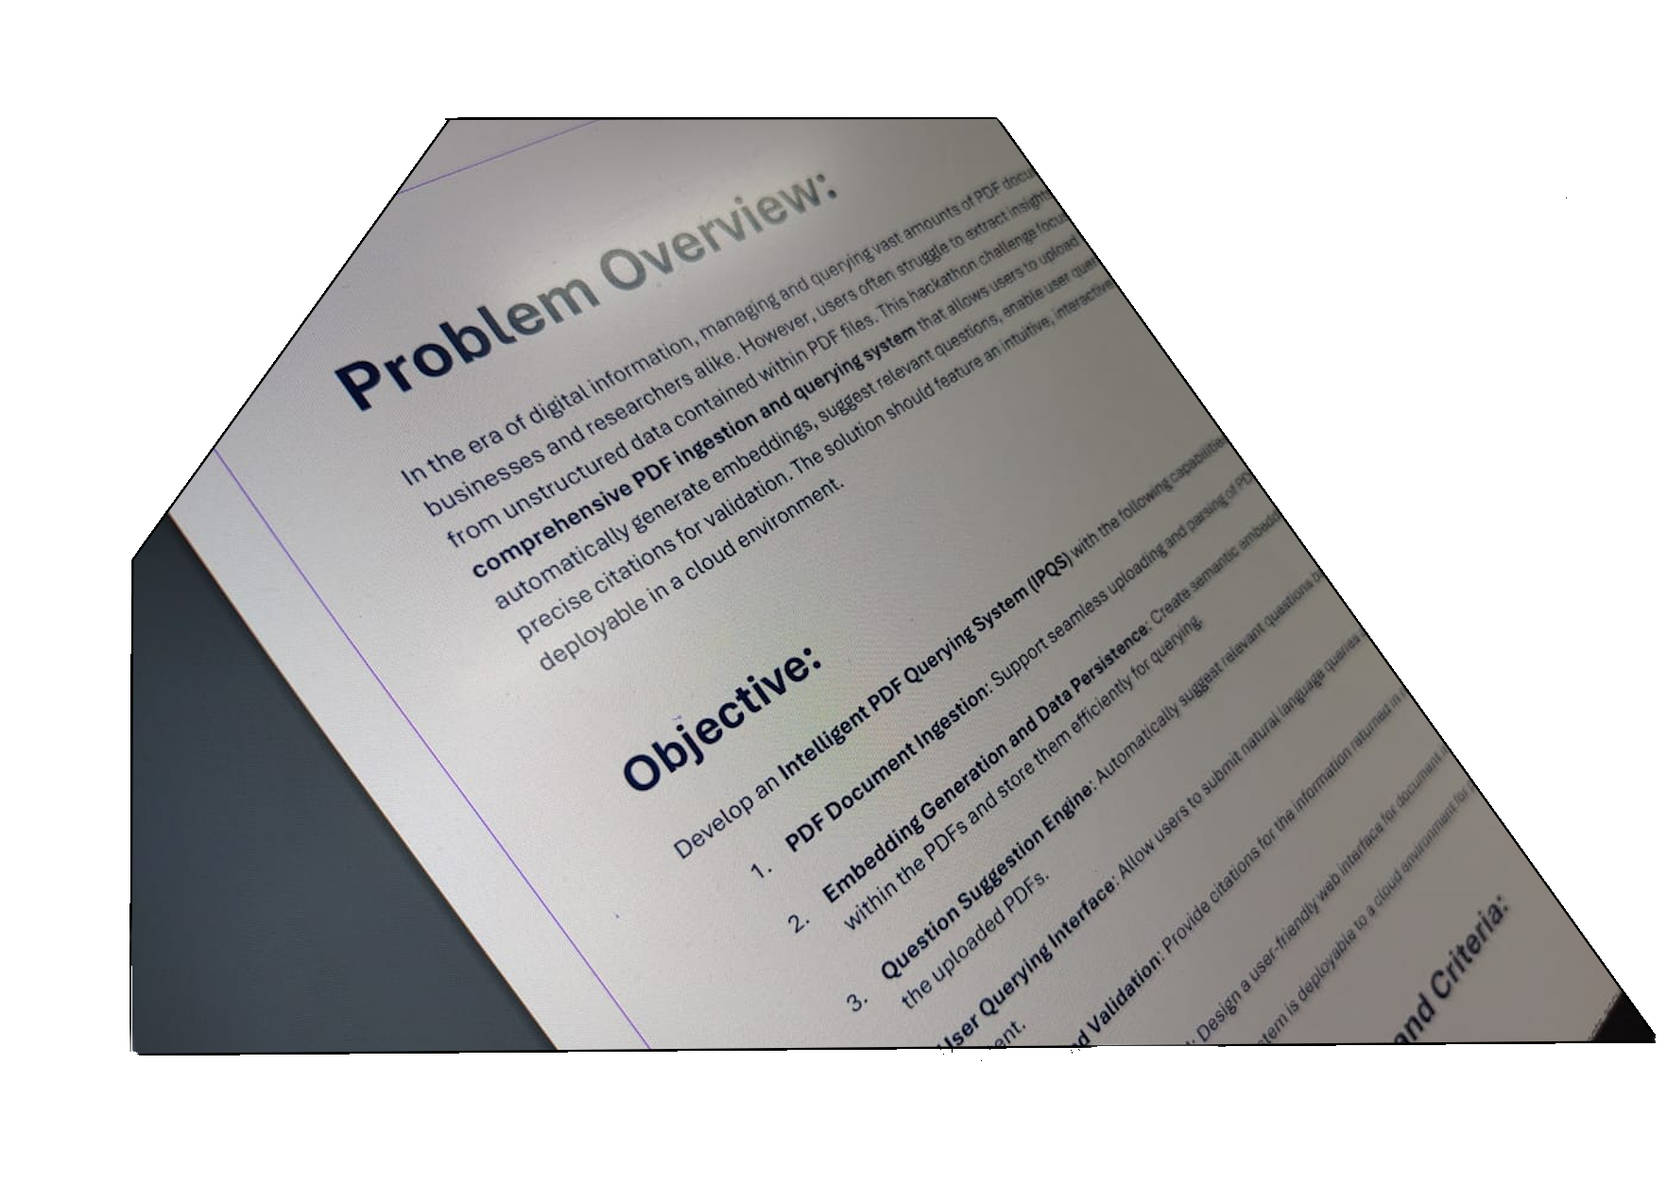
01
AIM of project

Slide 6
Problem
Creating an Intelligent PDF Querying System and deploying it using the cloud in the form of a Notebook style web app.

Slide 7
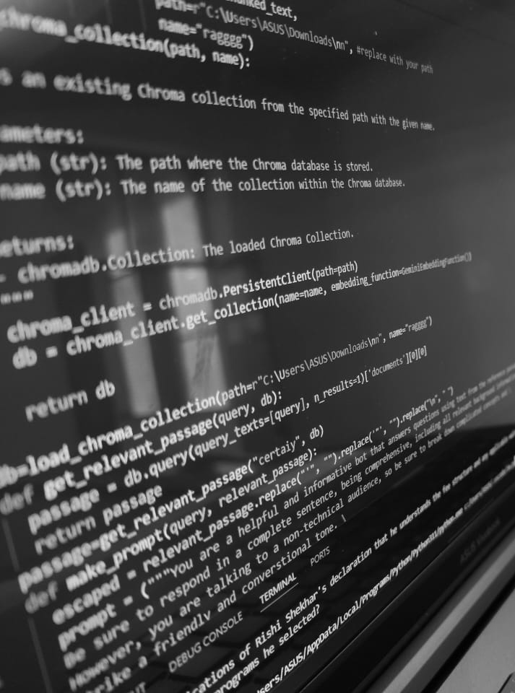

IPQS
A PDF ingestion and querying system designed to
streamline document management. This solution
allows users to seamlessly upload PDF documents,
automatically generate embeddings for
deeper data analysis, and suggest relevant
questions for enhanced engagement.

Slide 8
02
conceptualizing solutions
Designing a algorithm to solve the problem.

Slide 9
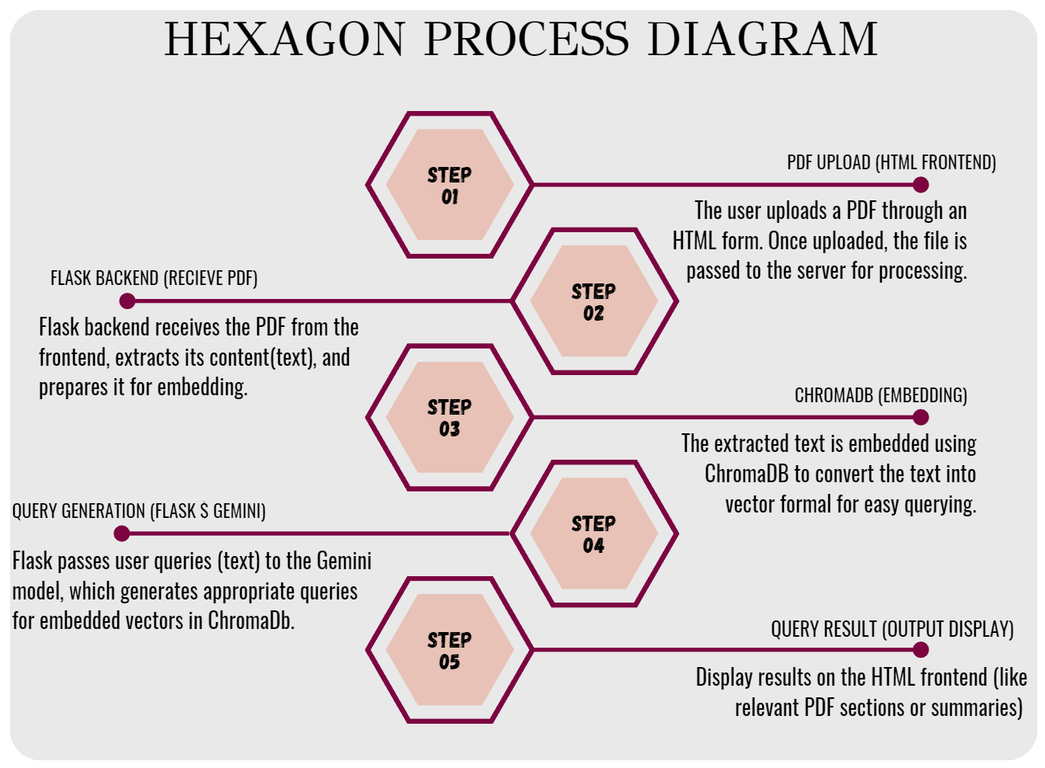

Slide 10


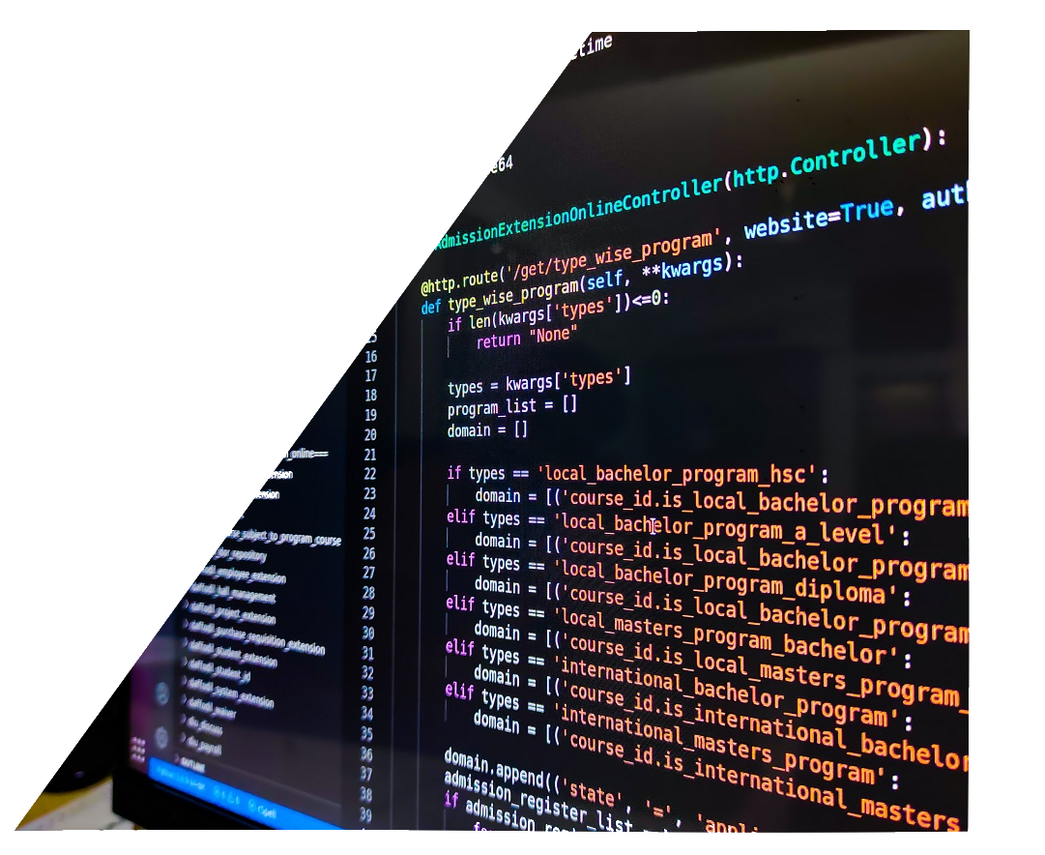
03
Developing program
Frontend and Backend development

Slide 11
Description of program
Develeopment
Frontend
backend
Webpage
User interface
Database
LLM-AI
User interface and webpage
Vector Database and LLM AI
Creating a webpage using html and css.
Injecting code into the webpage to make it easier for the user to navigate.
ChromaDB used for storing and retrieving vector embeddings.
Gemini 1.5 Pro

Slide 12
04
Concluding the Assembly
Linking everything together

Slide 13
Concluding the assembly
On the front end side we first started linking together the different webpages we made and adding the code necessary for the user interface. Then we started preparing the webpage and userinterface for integration with the backend using flask.
For the back end we used chroma DB for storing vector database with large language model API which reads the contents of the PDF and suggests questions, solves the user’s queries and provides citations from the PDF in response to user queries
We used python to create the programs which facilitates the connection between the vector database and the large language model.
Then we linked the frontend and backend together and completed the app.
Finally we hosted the app of a web hosting surface.

Slide 14
Lessons we learned
We learned a lot from this hackathon. This was the first hackathon our team attended and was a learning experience for us all. We learned how to work in a development environment and how to coordinate with several teammates while distributing work.
This will be a lesson we shall remember for the rest of our lives and will prove itself to be
essential for us in the future in the industry.

Slide 15


Thanks
+91 9773873675
pathakanubhav74@gmail.com
AlphaByte CodeKRaft

